Slide 1
Volume 5:
Writing Memorials

Slide 2
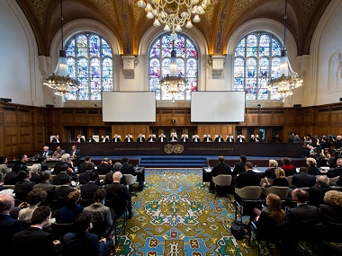

The IACHR System
7a
Individuals or groups harmed by states go to the Inter-American Commission on Human Rights
If the commission finds possible violations of human rights, the case is referred to the Inter-American Court of Human Rights (IACHR)
The IACHR is a court of last resort
It is an adversarial system in which cases are presented in the form Victim(s)/Petitioners v. State
THE IACHR LEGAL PROCESS

Slide 3
7b
What is a Memorial?
A petition or representation made by one or more individuals to a legislative or other body. When such instrument is addressed to a court, it is called a petition.
The Basics of Memorials
Each team submits TWO written memorials, one from each team member.
The team member designated to argue the side of the wronged party, or plaintiff in a civil case, is the PETITIONER. The other member represents the accused government, or the STATE.
Each memorial is a legal argument designed to convince the court to rule in the author’s favor in the hypothetical case provided.
Memorials are judged and scored by a panel of judges, and comprise 50% of the team’s initial score.
The petitioner and state memorials each average around 15-20 pages, and can not be more than 40 each.
IACHR MEMORIALS: BASICS

Slide 4
7c
Table of Contents
Index of Authorities
Statement of Facts
Legal Analysis
Request for Relief
Title Page
Format: Rule 10.5
Format: Rule 10.6
List of Books and Legal Cases Cited in Memorial
Brief Description of Each Item Explaining Its Relevance to the Case
A list of stipulated facts and necessary inferences taken from the case and/or clarification questions.
May not include argumentative statements, legal conclusions, distorted opinions, or interpretations of the facts.
Basically not your own work, but a list of the parts of the hypothetical case and clarifications that you intend to use in your case.
Analysis of admissibility issues
Analysis of applicable law
This is your interpretation of why you should win your case, based on other decisions rendered in the past.
A list of what you are seeking the court to do or give you
Petitioners seek repayment or restitution
State seeks dismissal or finding of no fault
LEGAL MEMORIAL LAYOUT

Slide 5
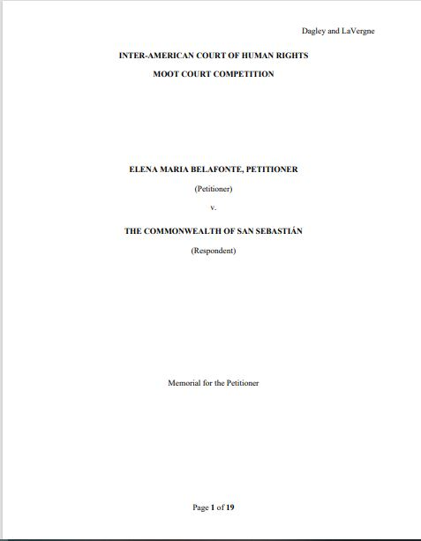
7d
THE TITLE AND TABLE PAGES

Slide 6
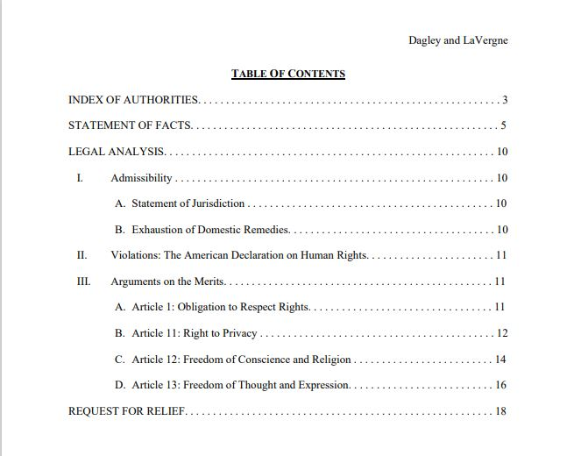
7e
THE TITLE AND TABLE PAGES

Slide 7
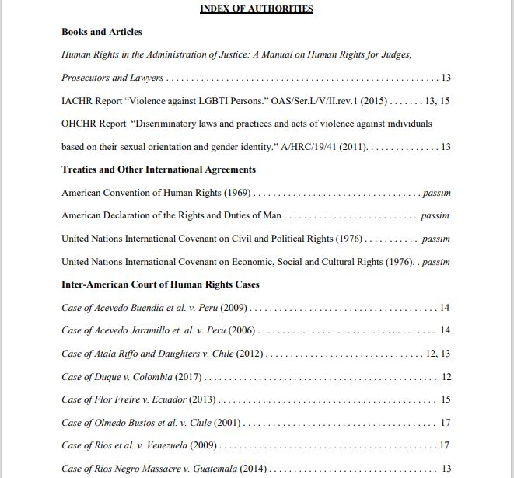
7f
INDEX of AUTHORITIES

Slide 8
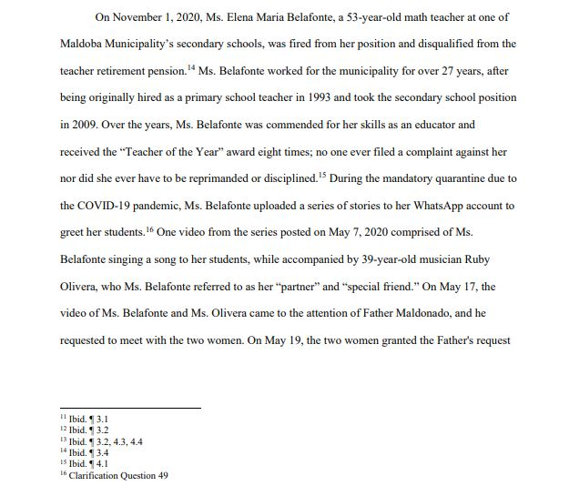
7g
STATEMENT of FACTS

Slide 9
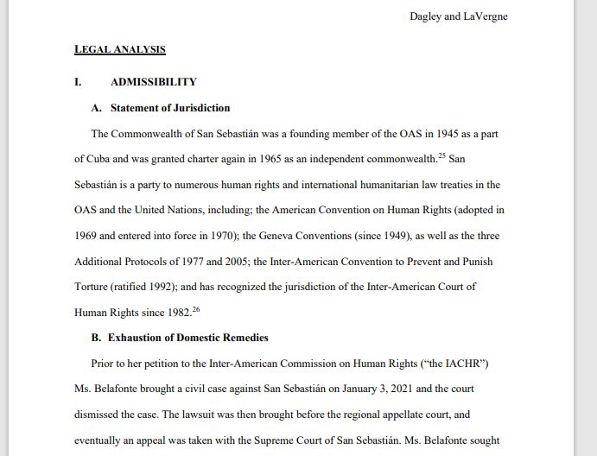
7h
LEGAL ANALYSIS:
Admissibility

Slide 10
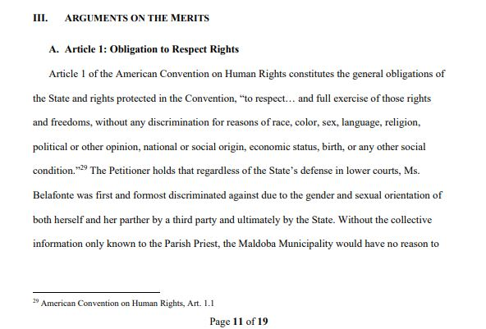
7i
LEGAL ANALYSIS:
Arguments on the Merits

Slide 11
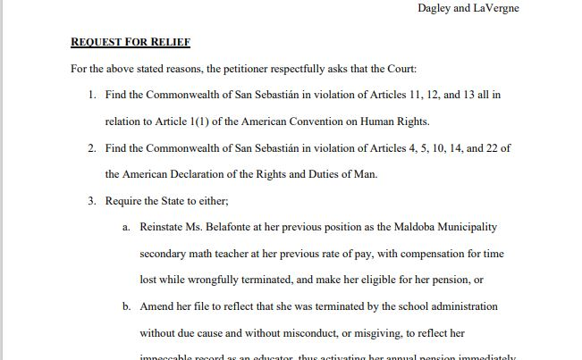
7j
REQUEST for RELIEF

Slide 12
7k
CREAC Method
Conclusion
Rule
Example
Analysis
TIPS for WRITING WELL

Slide 13
7l
Grab Attention
Short, Simple, Concise
Specific Details
Cut the Clutter
Roadmapping & Signposting
Citations, Citations, Citations!
TIPS for WRITING WELL

